Slide 1
Agile Coaching
Dirk Riehle, Univ. Erlangen
AMOS B06
Licensed under CC BY 4.0 International

Slide 2
Agenda
Agile coaching
Process improvement
Sprint retrospectives
Release retrospectives
Project retrospectives
Documentation

Slide 3
1. Agile Coaching

Slide 4
Agile Coaching
A coach is a person in relationship to another person or team who
Guides, collaborates, and supports the person or team
With respect to achieving their goals
An agile coach is a coach for agile teams
Agile coaches don’t make decisions or manage the team (unlike in sports)
Which is unfortunate given that Scrum is a sports metaphor
Agile coaching is what an agile coach does

Slide 5
Agile Coaching vs. Scrum Master
A Scrum Master helps a Scrum team
Perform at highest possible levels
An agile coach is a Scrum Master
With a broader outlook than just Scrum

Slide 6
The AMOS Coach
The AMOS coach is a Scrum Master
For the purposes of the development project
The AMOS coach goes beyond being a Scrum Master by
Conceiving and performing a team workshop

Slide 7
2. Process Improvement

Slide 8
Process Improvement
Process improvement is the practice of
Continuously improving a team’s performance by
Observing, reflecting on, and adapting the team’s behavior

Slide 9
Retrospectives [1]
In Scrum, process improvement is triggered through retrospectives
A retrospective is
[1] Kerth, N. (2001). Project Retrospectives. Addison-Wesley.

Slide 10
Kerth’s Prime Directive

Slide 11
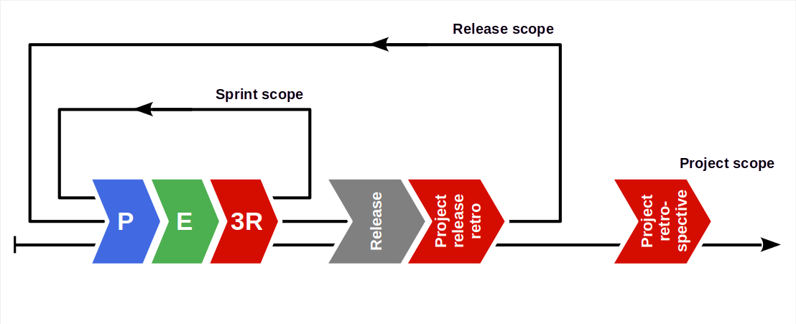
Retrospectives in Scrum

Slide 12
3. Sprint Retrospectives

Slide 13
Sprint Retrospective
A sprint retrospective is a retrospective that
…

Slide 14
4. Release Retrospectives

Slide 15
Release Retrospective
A release retrospective is a retrospective that
…

Slide 16
5. Project Retrospectives

Slide 17
Project Retrospective (a.k.a. Post-Mortem)
A project retrospective is a retrospective that
…

Slide 18
6. Documentation

Slide 19
Regular Deliverable: Documentation
Please create an initial documentation and keep it up-to-date

Slide 20
Summary
Agile coaching
Process improvement
Sprint release retros
Project release retros
Project retrospective
Documentation

Slide 21
Thank you! Any questions?
dirk.riehle@fau.de – https://oss.cs.fau.de
dirk@riehle.org – https://dirkriehle.com – @dirkriehle

Slide 22
Legal Notices
License
Licensed under the CC BY 4.0 International license
Copyright
© Copyright 2009, 2024 Dirk Riehle, some rights reserved

